Slide 1

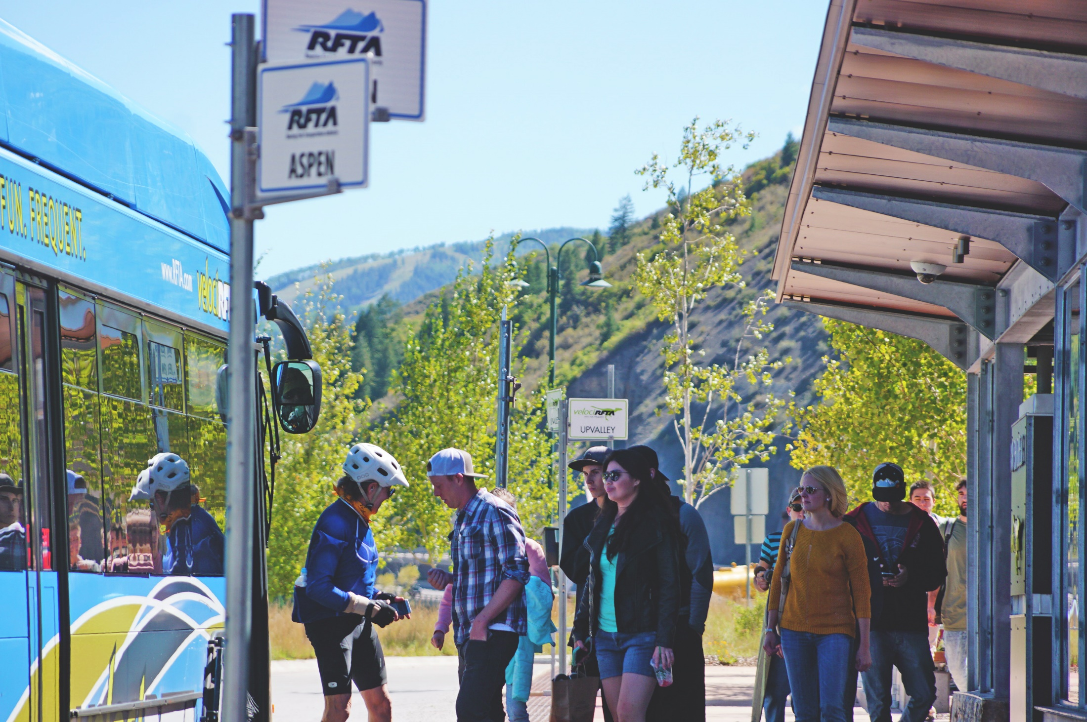

RFTA Destination 2040

Slide 2

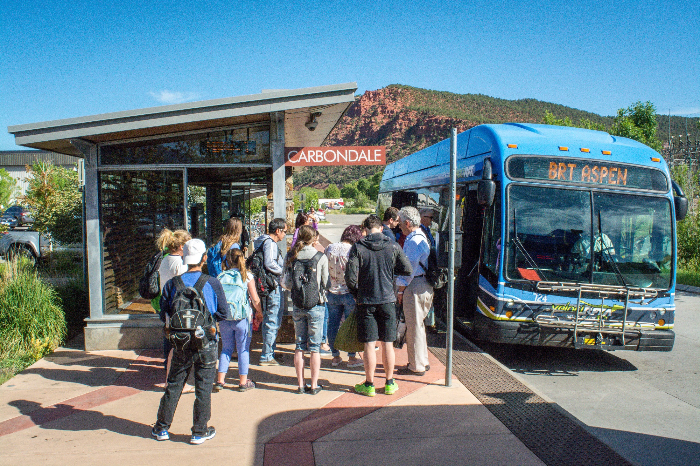
Agenda
RFTA Overview
2015 Board Retreat Background
Destination 2040 Overview
Questions

Slide 3
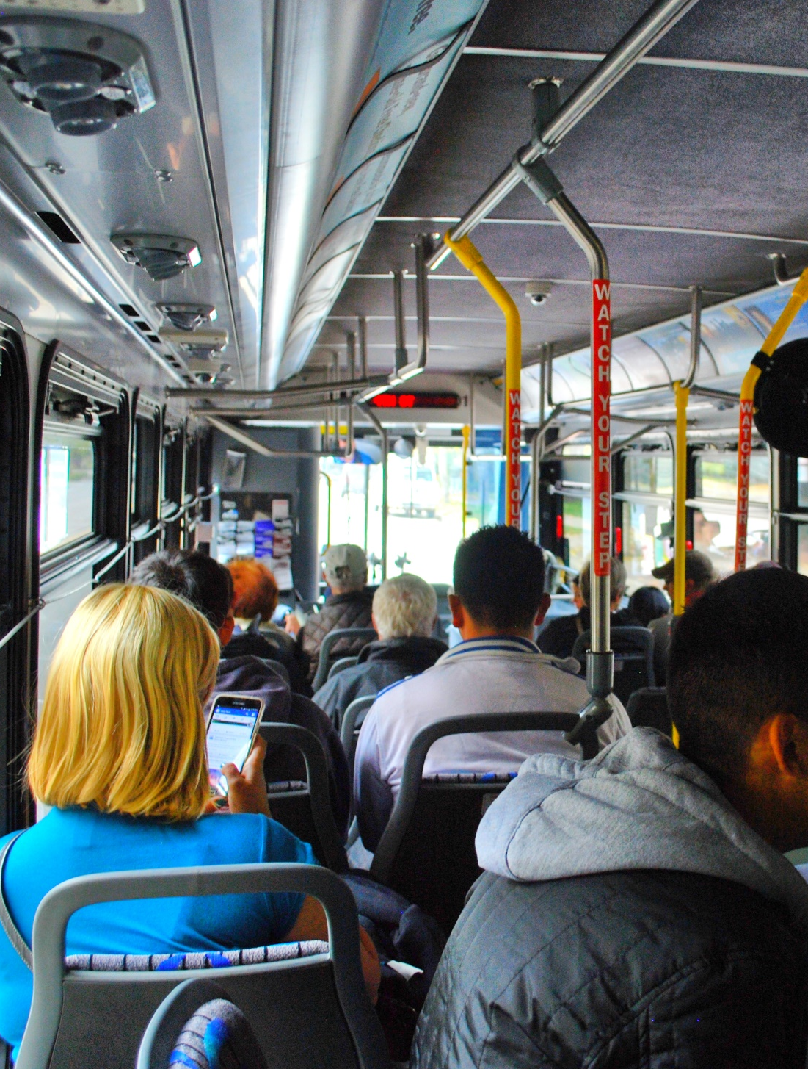
RFTA Overview
RFTA:
2nd Largest public transit system in Colorado after Denver RTD
Largest rural public transit system in the U.S.
Received 2012 White House Champions of Change Award
Implemented first Rural BRT System in the United States, in September 2013
Received 2014 Federal Transit Administrator’s Award for Outstanding Public Service
Received the ACRA 2017 Non-Profit of the Year Award
Received the Colorado Association of Transit Agencies 2018 Large Community Transit Agency of the Year Award
Notes:
3

Slide 4
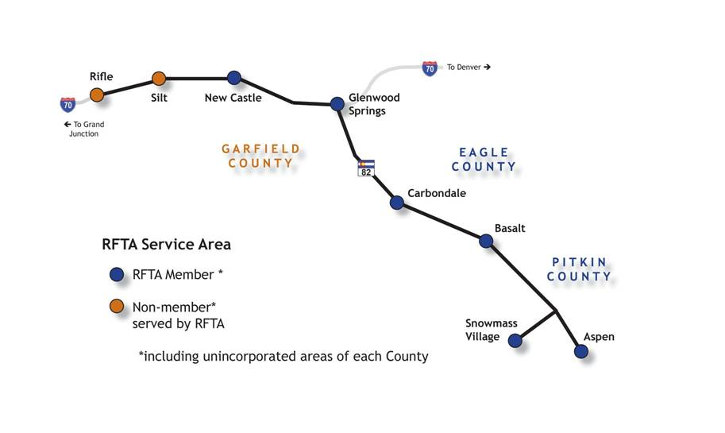
RFTA Service Area
Notes:
4

Slide 5
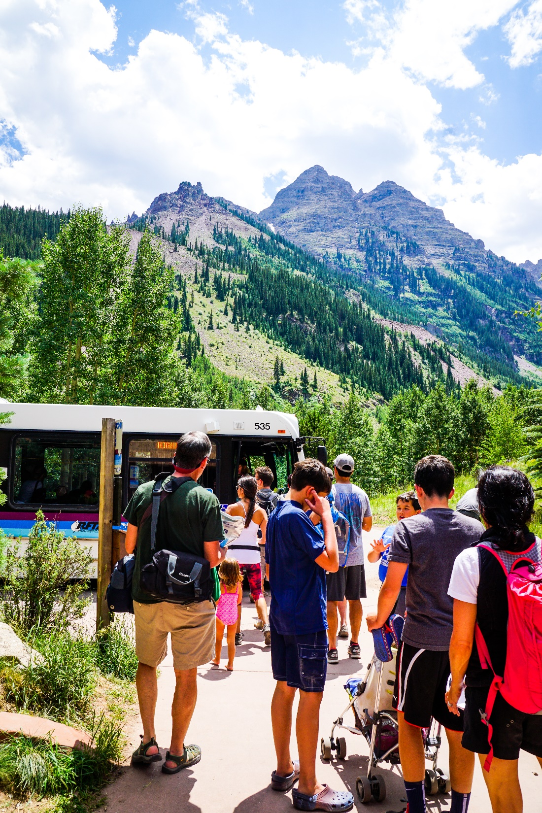
RFTA Metrics
2017
5.57 million passengers
5.37 million miles of service
350 employees during peak winter season
106 large transit vehicles (29 CNG), 22 vans
70-mile corridor
  Aspen to Glenwood Springs
  Glenwood Springs to Rifle
34-mile Rio Grande Rail Corridor and Trail
$44.5 million budget
  $34.8m Operating
  $4.83 Capital
  $4.86m Debt Service)
Notes:
5

Slide 6
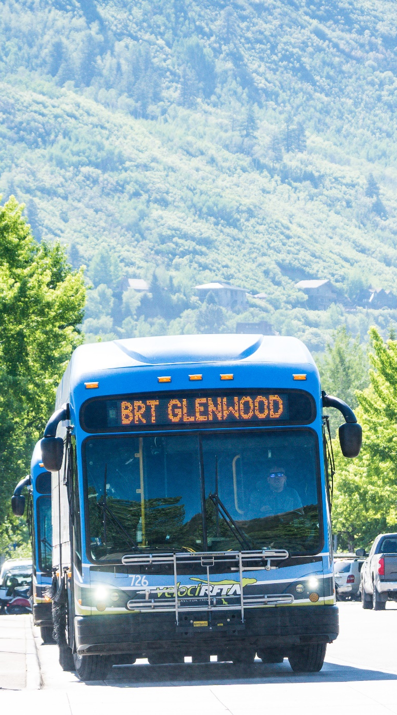
RFTA Service Highlights
  Bus Rapid Transit VelociRFTA service in the Hwy 82 corridor
  Commuter service in the Hwy 82 and I-70 Corridors
  Local service Aspen, Glenwood Springs, and Carbondale
  Bike Share We-Cycle in Aspen, Basalt and El Jebel
  Public Lands Access through Maroon Bells bus tours in partnership with USFS and also serve Aspen Skiing Company’s 4 major ski areas in White River National Forest
  Construction Mitigation Grand Avenue Bridge
  Rio Grande railroad corridor 34-mile paved recreational
  hiking-biking trail
  Special event services for major local events (ESPN’s
  X-Games: up to 59,000 trips per day)
  Pilot Battery Electric Bus Program, beginning in 2020,
  possibly using community solar power for charging
Notes:
6

Slide 7
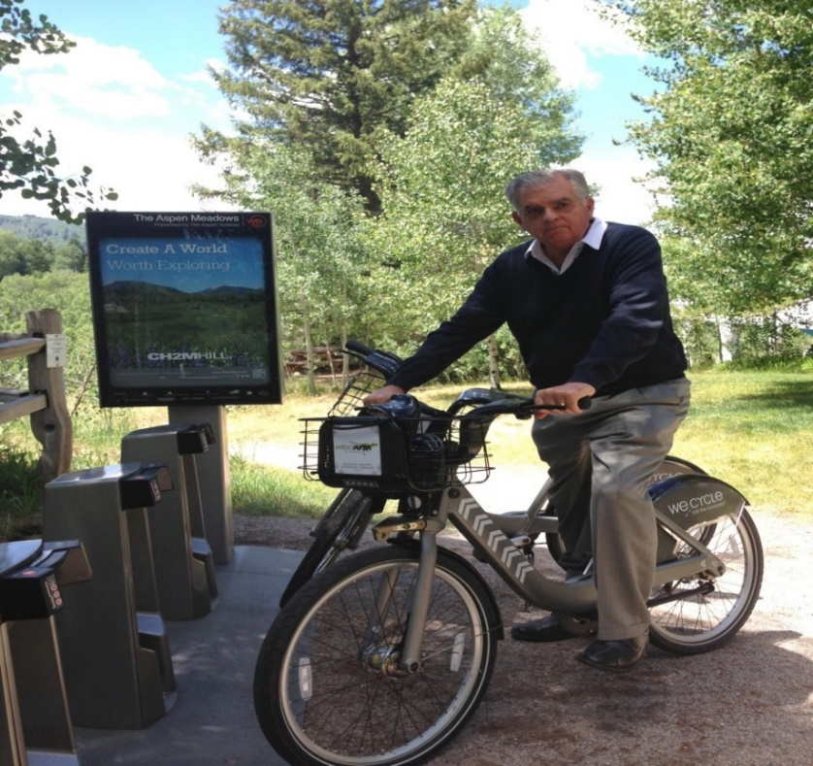
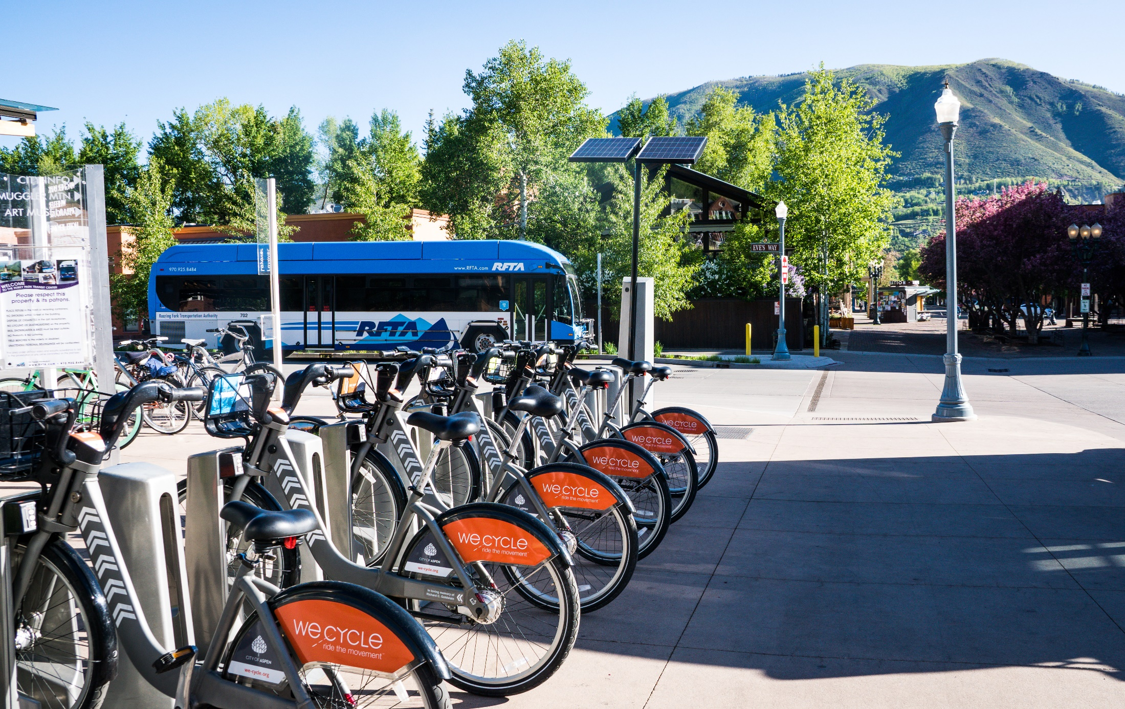
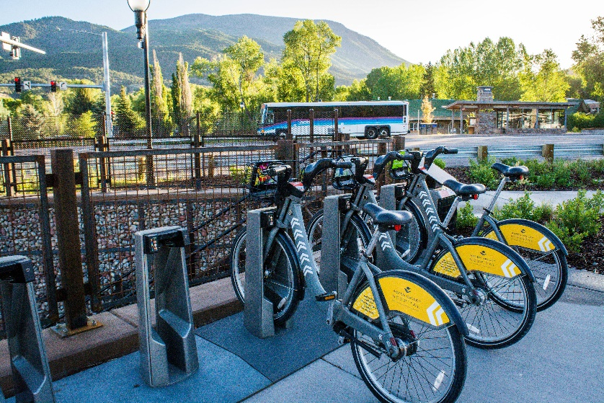
We-Cycle Regional Bike Sharing

Slide 8
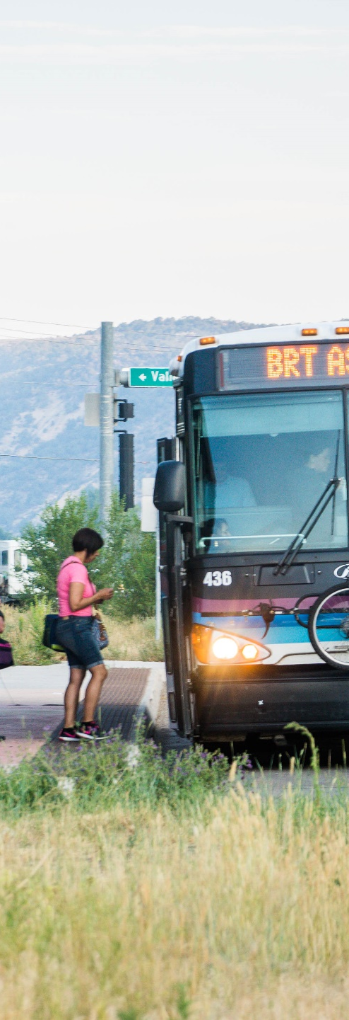
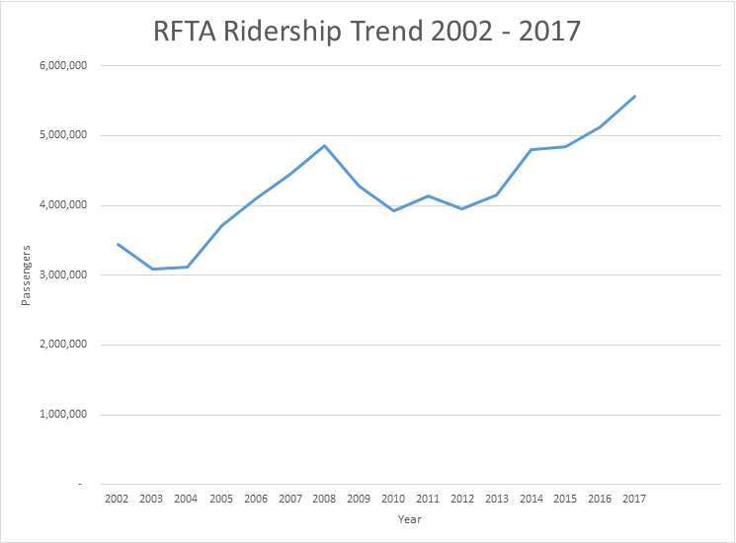
RFTA Ridership

Slide 9
RFTA Ridership

Slide 10
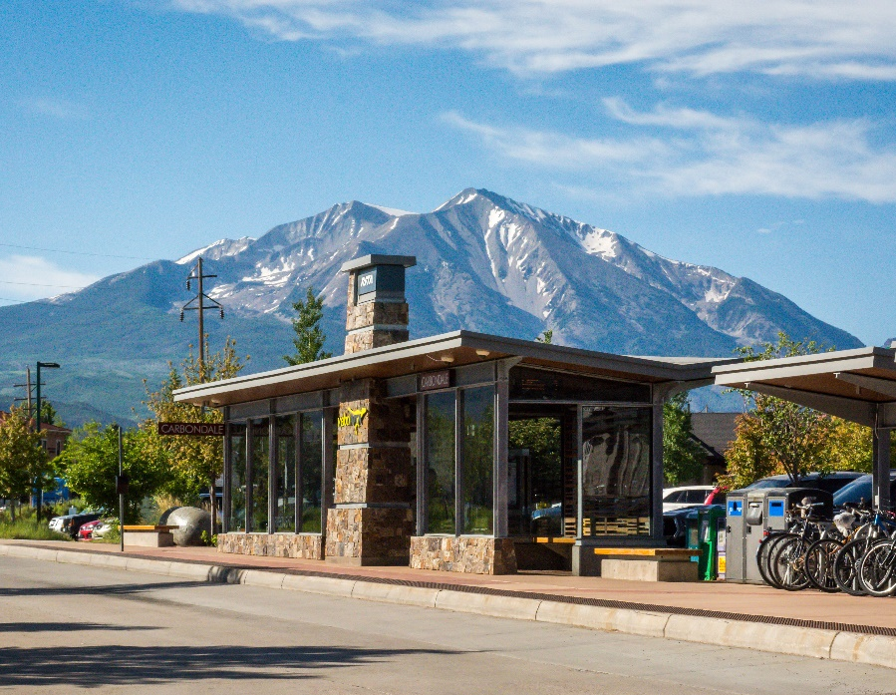
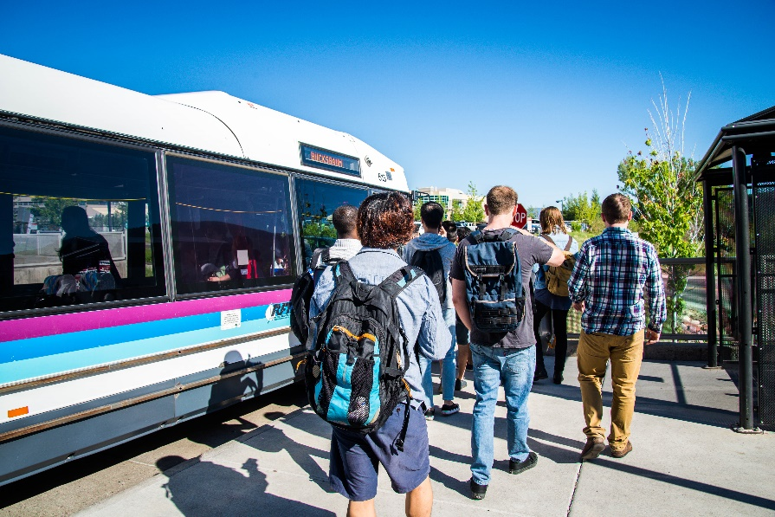
Enhance versus Expand
RFTA has undertaken 4 major service expansions: 1994-95, 2001-02, 2006-07, and 2013-14.
RFTA faces significant challenges to maintain existing service levels, to recruit and retain skilled employees, and to maintain its existing facilities and equipment in a State of Good Repair.
Should RFTA plan for additional major service expansions or should it plan to grow more gradually and incrementally?

Slide 11



Destination 2040
Notes:
Andrea, Dan, Ralph

Slide 12

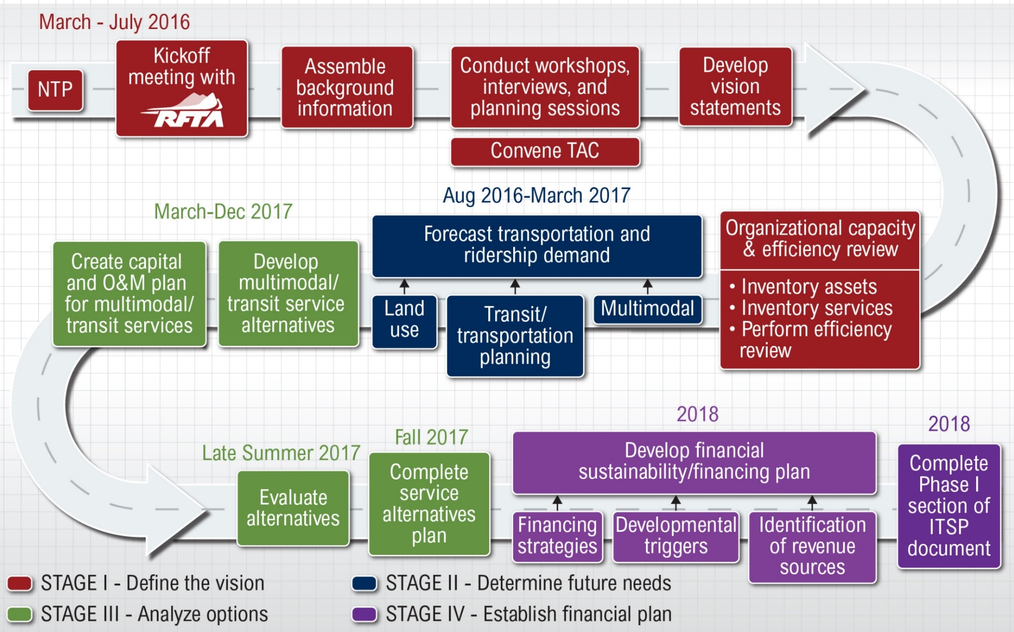
Destination 2040

Slide 13
Destination 2040
Active Stakeholders
Snowmass Village
Basalt
Pitkin County
Aspen
Glenwood Springs
Carbondale
New Castle
Silt
Garfield County
Eagle County
Rifle
Parachute
Aspen Valley Hospital
RE 2 School District
RE 1 School District
Valley View Hospital
Grand River Medical Center
ECO Transit
CDOT Division of Transit & Rail
CDOT Region 3
Rifle Economic Development Corporation
Mid Valley Planning Commission
Aspen Ski Company

Slide 14
Destination 2040
What We Heard in Stage 1
Optimize and increase transit service including community circulators, direct/express routes, existing bus rapid transit on SH82 and expanded bus rapid transit service on I-70 to Parachute
Better connect pedestrian/bicycle routes to transit, including connecting Rio Grande trail to Brush Creek station, and adding more pedestrian underpasses
Better connect to other transit services such as Bustang, ECO Transit, and community circulators
Expand existing and add new park and ride facilities
Construct and maintain LoVa trail
Potential fixed guideway transit from Brush Creek station to Rubey Park
Expand on-demand services such as bikesharing (WE-cycle), ridesourcing (Uber, Lyft), carsharing (car2go, Zipcar)
Expand intelligent transportation systems/technology services such as google maps schedule integration, regional app-based trip planner
Expand maintenance facilities to keep up with fleet demand
Expand employee housing to keep up with staff demand
Offer more accommodations for bicycles on buses

Slide 15
Destination 2040
RFTA Efficiency and Organizational Structure Review
Unique and highly efficient agency
Accomplished 4 major service expansions since 1994
Lean organization is highly cost effective
RFTA vehicle fleet is in overall good condition but needs approximately 88 replacement buses in next 15 years
Additional capital needs include expansion of transit services and facilities, including along the I-70 corridor

Slide 16
Destination 2040
Challenges
Broad mix of transit services, fleet, O&M facilities, pedestrian crossings, park-n-rides, employee housing, recreational trail
Service area is geographically vast and demographically diverse
Five unique seasons with different sets of transit demands

Slide 17
Destination 2040
Challenges Continued
Growing population/employment and demand for transit services
Funding needs for growing O&M costs, plus fleet replacement, facilities, park-n-rides, employee housing, and other capital costs

Slide 18

Destination 2040
New 2.65 Mill Levy Scenario
Responded to latest Polling results
Constrained the Destination 2040 project list
Assumed GMF expansion project funded 50/50 by 2018 State-wide Transportation Ballot initiative or grants
Preserves service improvements

Slide 19
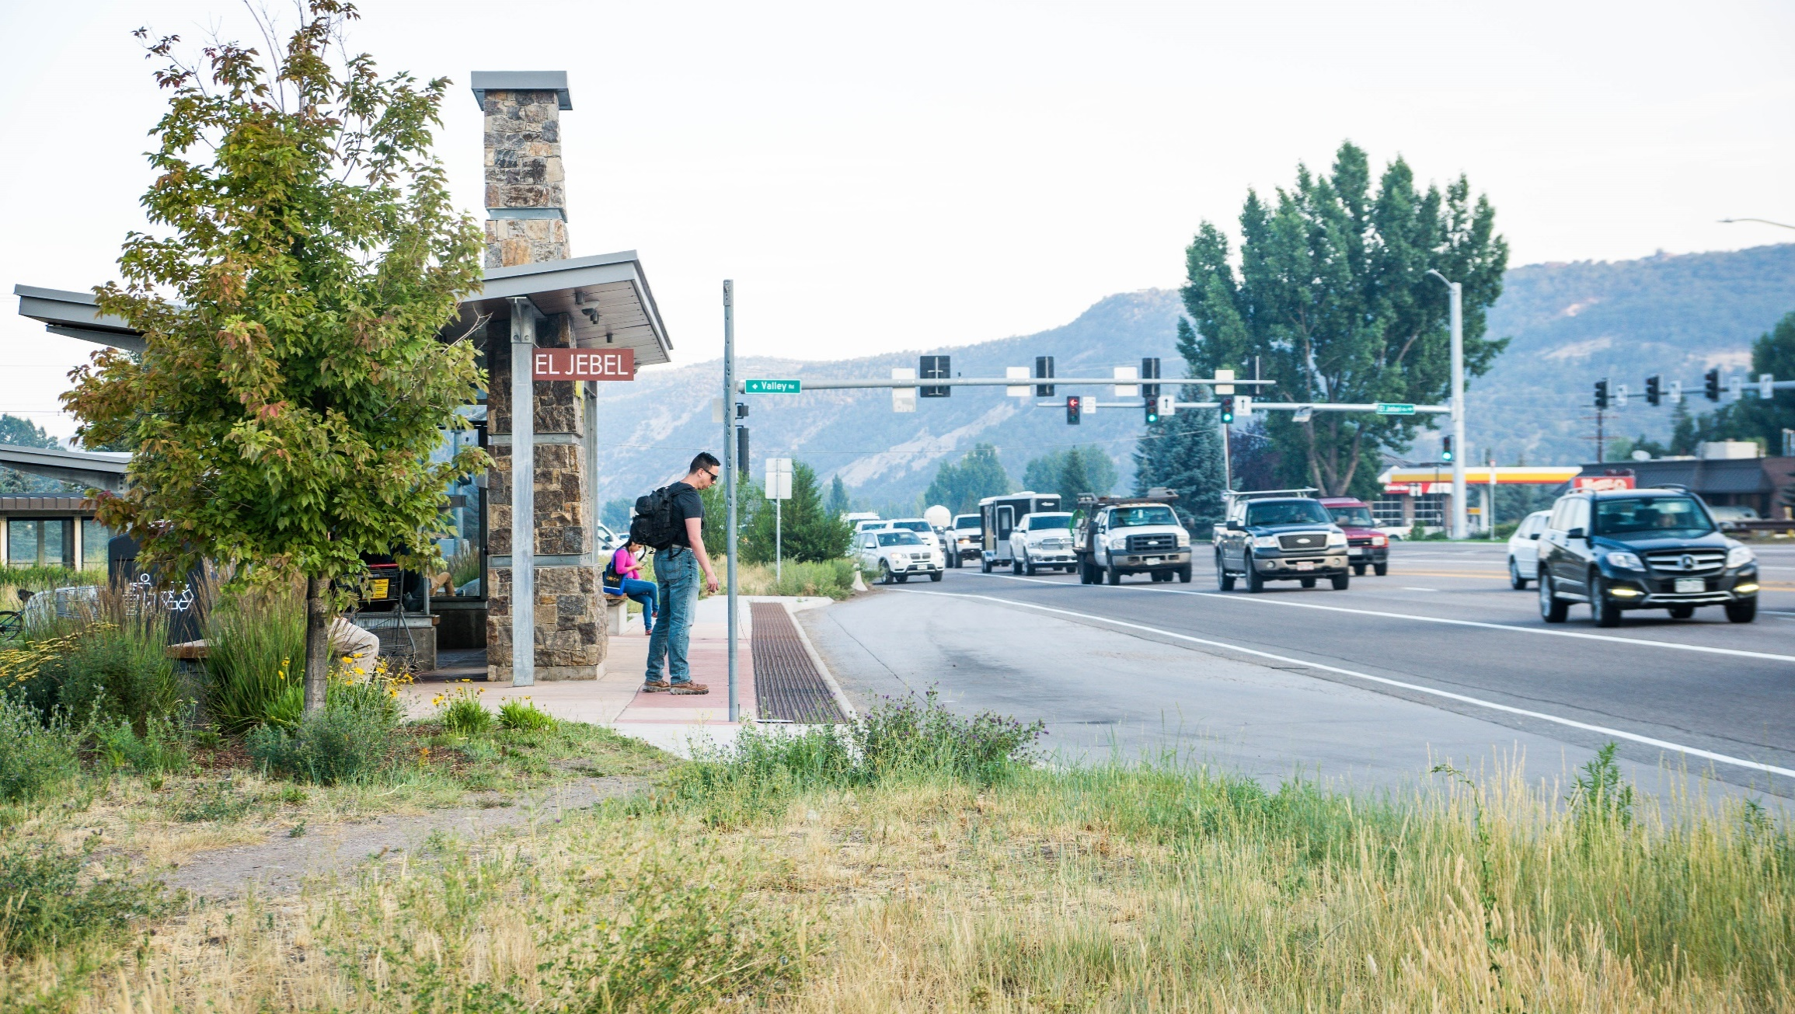
Destination 2040
Assumptions for
2.65 Mill Levy Scenario
4% average annual increase in assessed valuation
5% reduction in existing BRT service (as a placeholder)
6.11% residential property assessment rate effective 2019
A reduction of 6 expansion buses, but still includes 10 additional buses

Slide 20
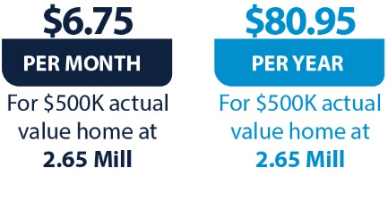
What would a proposed 2.65 RFTA Mill Levy Cost a Homeowner?
Assessment Rate of 6.11%
Destination 2040
Notes:
Note new rate

Slide 21
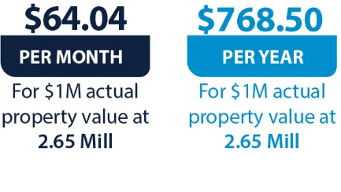
What would a proposed
2.65 RFTA Mill Levy Cost a Commercial Property Owner?
Assessment Rate 29%
Destination 2040

Slide 22

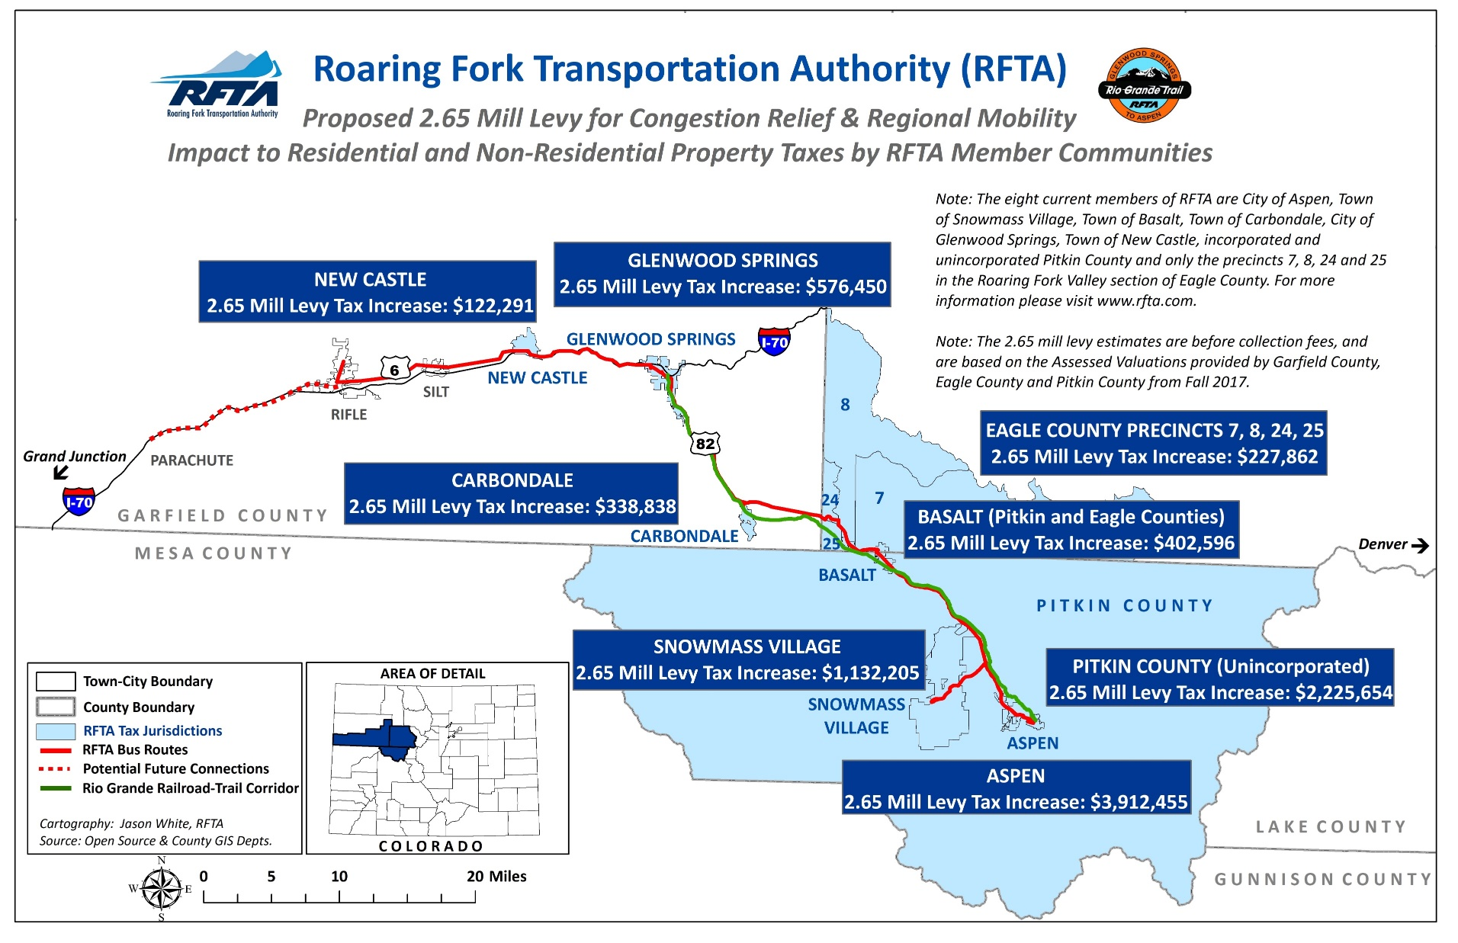
Destination 2040

Slide 23
If 7A doesn’t pass…
Destination 2040
RFTA will likely be forced to reduce regional services by as much as 20 percent in the next few years in order to pay for essential bus replacements and maintain a positive fund balance.
If RFTA keeps the current service with bus replacements, it will face a yearly deficit and negative fund balance starting in 2027.
Little or no ability to leverage additional State and Federal funds.

Slide 24
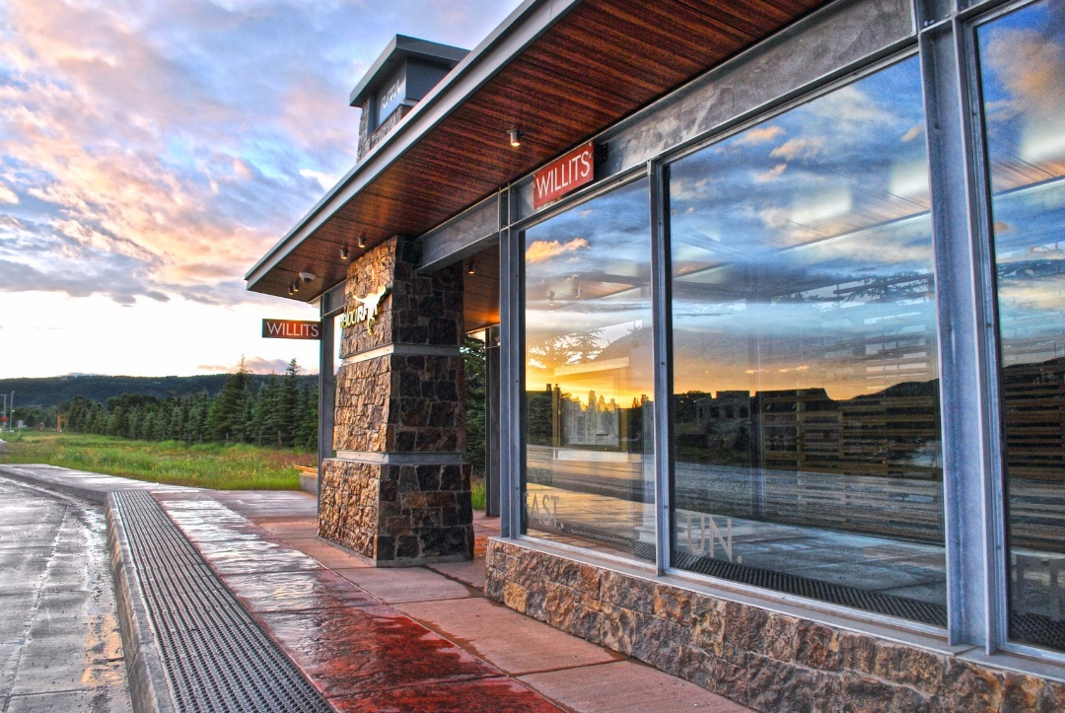
Questions / Discussion
Dan Blankenship, CEO
Roaring Fork Transportation Authority
970-384-4981
dblankenship@rfta.com
www.rfta.com
www.rfta2040.com

